Slide 1
Unit 4 ⏐Assignment – PyCitySchools
SMU Data Science Bootcamp Zeinab MASSUDI

Slide 2
Contents
Introduction: Context & Objectives
Methodology
Results
Conclusions

Slide 3
1.1. Introduction > Context & Objectives
Context
Objectives
The task was to aggregate the data and calculate each of the following (by school, school type and budget brackets):
Total Students
Total School Budget
Per Student Budget
Average Math Score
Average Reading Score
% Passing Math
% Passing Reading
Overall Passing Rate (Average of the above two)
In order to make strategic decisions regarding future school budgets and priorities, the school board and mayor expressed the need for detailed insights into current school performances within the district.
Hence, our task was to analyze the district-wide standardized test results and showcase obvious trends in school performance.

Slide 4
Contents
Introduction: Context & Objectives
Methodology
Results
Conclusions

Slide 5
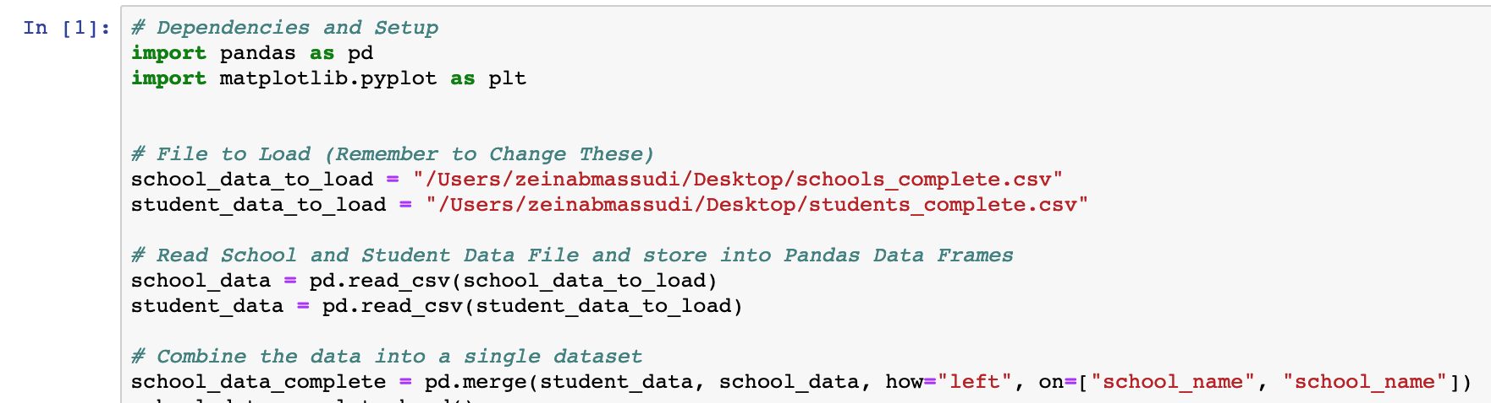
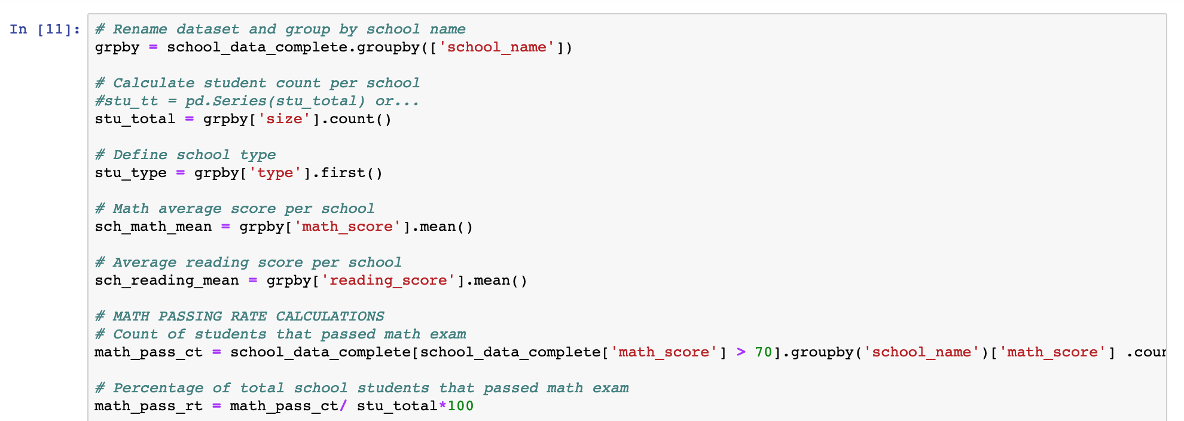
2.1. Methodology > PyBank
Our approach is made up of several logical steps using methods, functions and conditions to merge and analyse the district school data and the schools’ generated math and reading exam resultsdataset.
1
Importing libraries and merging datasets
The data was analysed using Pandas, a software library for the Python programming language, that provides high performance data structures and data analysis tools.
2
Aggregating data by School, School Size and School Type using “groupby” function
The groupby function splits the data into groups based on a particular criteria. Groups can also be formed by more than one category and condition.

Slide 6
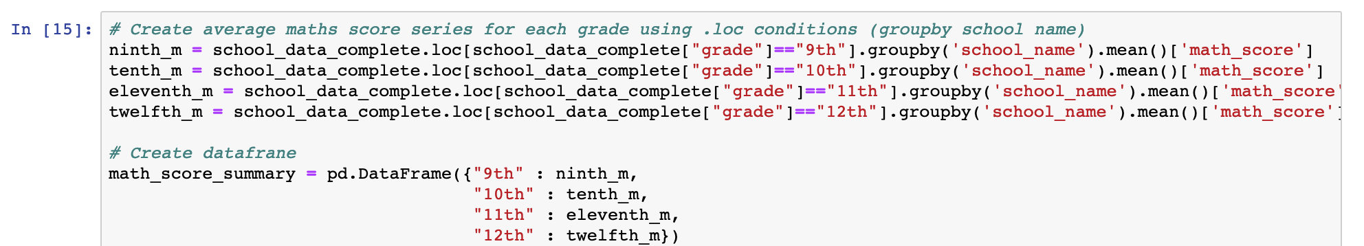
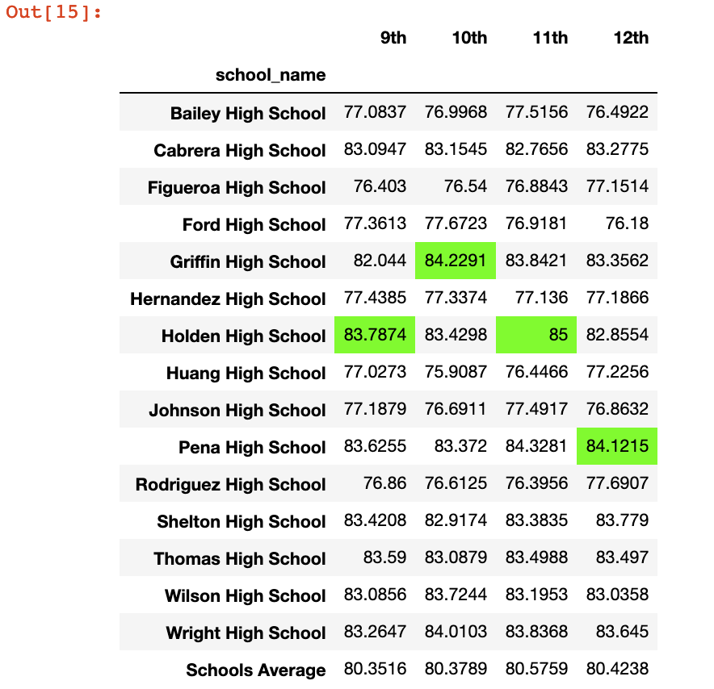
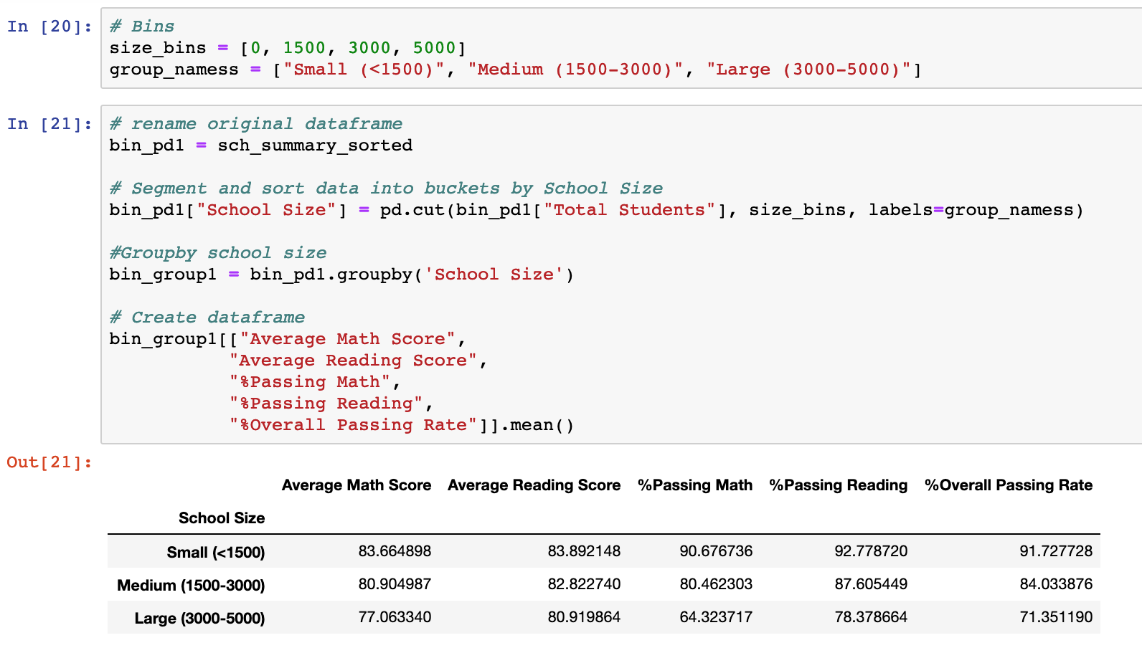
2.1. Methodology > PyBank (cont.)
3
Extracting specific grade columns using .loc method to analyse various grade performance
.loc is a method that allows the retrieval of rows from a dataframe using index labels and returns the row if its index exists in the caller dataframe.
4
Creating School Size and Budget per Student Brackets using “Cut” function
The cut function segments and sorts data into pre-defined bins (brackets).

Slide 7
Contents
Introduction: Context & Objectives
Methodology
Results
Conclusions

Slide 8

3.1. Results > Summary
Overall, students attending Charter Schools outperformed those of district schools despite the fact that district schools had higher budgets per student.
Budget Per Student vs Overall Pass Rate
n(Total) = 15 schools, 39,170 students; | n(sCharter) = 8 schools, 12,194 students | n(District) = 8 schools, 26,976 students
Charter school yielded an average overall passing rate of 92% (20% higher than District schools).
District schools tend to have higher budgets than Charter Schools.
District schools are medium and large sized.
The data also suggests that higher per student budgets doesn't ensure higher overall exam success.
School size could have an impact on its performance.
Note : marker size reflects school size.

Slide 9
Contents
Introduction: Context & Objectives
Methodology
Results
Conclusions

Slide 10
4. Conclusions
As a whole, schools with higher budgets, did not yield better test results. By contrast, schools with higher spending per student ($645-675) underperformed compared to schools with smaller budgets(<$585 per student).
Top and Bottom Performing Schools
District schools students were the poorest performers especially in math with an overall passing rate average of 71%. On the other hand, Charter school yielded an average overall passing rate of 92%.
Larger budgets do not produce better results
As a whole, schools with higher budgets, did not produce better test results. By contrast, schools with higher spending per student ($645-675) underperformed compared to schools with smaller budgets(<$585 per student).
Impact of school size on performance
Overall, smaller and medium sized schools dramatically out-performed large sized schools on percentage math pass rate(92-84% passing vs 71%).
Other factors
Further analysis did not reveal any obvious trends of performance by specific gender groups or grades.
There are no coincidences to success. Hence, a deeper dive into charter and district schools best practices, policies and teacher/student ratio could help explain the disparity between their students’ performance.

